Slide 1
GROUP 4 MOVIE recommendation SYSTEM
RAHEEM NJAGI
WILLIAM MUTHAMA
CAROLINE KAMUSI
EVANS OCHIENG’
FRANCIS MUTHONI

Slide 2

Movie Recommendation System
Business Objective and Technical Overview

Slide 3
Business Objective
The movie recommendation system aims to enhance user engagement and satisfaction by providing personalized recommendations based on user ratings and preferences.

Slide 4
Data Sources
1. Ratings Data: User ratings of movies (e.g., ratings.csv).
2. Movies Metadata: Information about movies (e.g., movies.csv).
3. Tags Data: User-generated tags describing movies (e.g., tags.csv).
4. Links Data: External movie IDs (e.g., links.csv).
These were the datasets used to build the movie recommendation system

Slide 5
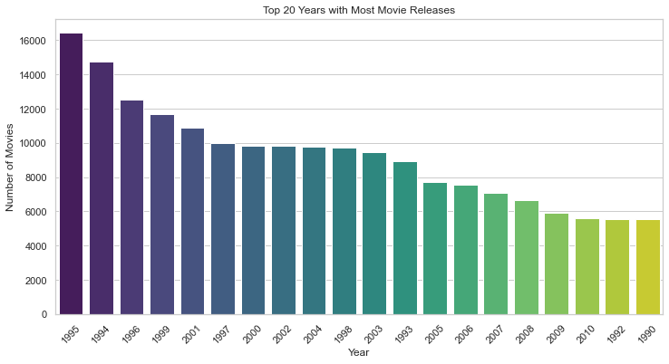
DATA INSIGHTS
ANNUAL MOVIE RELEASES
Across the years numerous movies were released.
Our data clearly captures the number of movies produced over the years.
The year 1995 being the year with the highest movies released

Slide 6
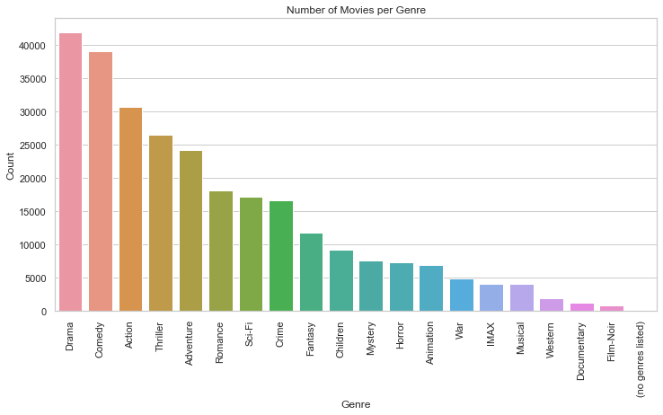

The released movies are of different genres(Drama comedy,documentaries etc)
The number of movies per genre also vary DRAMA being the movie genre with highest number

Slide 7
Collaborative Filtering (KNN)
- Uses K-Nearest Neighbors (KNN) to find users or movies that are similar. Based on cosine similarity to measure how alike two users/movies are. The model suggests items rated highly by similar users.

Slide 8
Recommendation Techniques
1. Collaborative Filtering: Predicts user preferences based on similar users.
2. Content-Based Filtering: Recommends movies similar to those the user has liked based on features.
3. Hybrid Methods: Combines both approaches to improve accuracy.

Slide 9
Evaluation Metrics
Root Mean Squared Error (RMSE): Measures how close predicted ratings are to actual ratings.
Mean Absolute Error (MAE): Measures the average magnitude of errors.
Precision and Recall: Evaluate the relevance of the recommendations.

